Slide 1
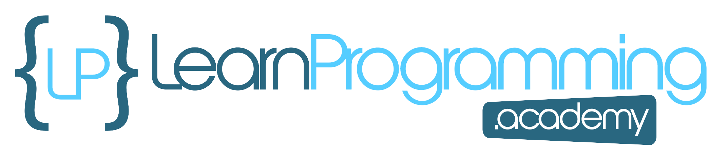
Introduction to the Course
If I just lost you when I used the term JDK that stands for Java Development Kit, and it's the software that is used to create Java programs. But we'll find out a lot more about that as we go through the course in detail.
But if you know something about the JDK you might be wondering, "Well Tim, why are you updating the course to JDK 17 " when JDK 19 is out already?
There is a very good reason for this, and in this section, there is a video titled "Which JDK?" which explains my reasoning for using JDK version 17.
But if you are running older versions of Java, say Java 11, or even Java 8 you will be able to follow along and get a lot out of this course. It's best to use Java 17 though.
COMPLETE JAVA MASTERCLASS
Introduction to the Course

Slide 2
Remaster in Progress
I'm currently in the process of remastering this entire course.
When the course came out in 2015 it focused on the then current version of Java, version 8. We’ve come a long way and now we are working on Java 17.
Some of the improvements include:
Incorporating features of Java 17
Adding slides that can be downloaded
Fixing errors in older videos
Addressing confusing concepts in more detail
COMPLETE JAVA MASTERCLASS
Remaster in Progress

Slide 3
Install JDK 17 for Windows
This is the Windows installation video - skip this if you are on a Mac or running Linux.
Right - so we've established that you want to install Java 17, or to be specific, JDK version 17.
This video will show you how to install on Windows 11. Note that if you are running on Windows 10, the installation will be pretty much identical. Just follow the steps you see in this video if you are running Windows 10.
The only potential gotcha is if you are running a 32 bit version of Windows 10 (these days most computers are running the 64 bit edition). In these rare cases you will find you need to download an older version of the JDK.
COMPLETE JAVA MASTERCLASS
Install JDK 17 for Windows

Slide 4
Install JDK 17 for Windows
If you have a relatively new PC from the past 4-5 years (or even a bit longer) then all should work.
Windows 11 only comes in a 64 bit version.
So if you are running Windows 10 or Windows 11, just follow along and assume your computer is running a 64 bit edition of Windows and it all should work fine.
COMPLETE JAVA MASTERCLASS
Install JDK 17 for Windows

Slide 5
Install JDK 17 for Windows
Great, so we now have the JDK installed, in the next video, it's time to download and install IntelliJ, which is the program we will be using in the course, that works with the JDK we just installed, to let you write and execute Java programs.
COMPLETE JAVA MASTERCLASS
Install JDK 17 for Windows

Slide 6
Install JDK 11 for Linux
In this video, we're going to install the OpenJDK version 17 on Ubuntu 22.04. If you are on Windows or macOS then check out the relevant videos for your operating system.
COMPLETE JAVA MASTERCLASS
Install JDK 11 for Linux

Slide 7
Confirming installation and intro to JShell
Now that we have Java installed on our machines, I want to introduce you to the software tool we'll be using to begin to explore the Java programming language. JShell.
Firstly, let's open a command prompt on Windows, or a Terminal in Mac or Linux, to check our Java version, to make sure we are ready.
COMPLETE JAVA MASTERCLASS
Confirming installation and intro to JShell

Slide 8
Confirming installation and intro to JShell
On Windows, you can press and hold the Windows key located next to the space bar, and then press the R key. This will take you to the 'Run' window, where you can type in cmd and hit the enter key.
On a Mac, you can press the Command key and spacebar at the same time, to get to Spotlight, and then type in Terminal. This should take you to the built in terminal on your Mac.
For Ubuntu Linux, click on 'show applications', in the bottom left of your screen. Then in the search bar, you can type in Terminal and hit enter.
COMPLETE JAVA MASTERCLASS
Confirming installation and intro to JShell

Slide 9
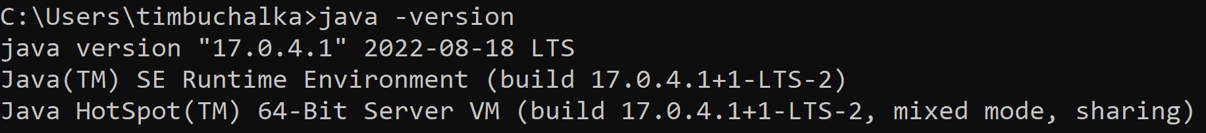
Java Version
COMPLETE JAVA MASTERCLASS
Confirming installation and intro to JShell

Slide 10
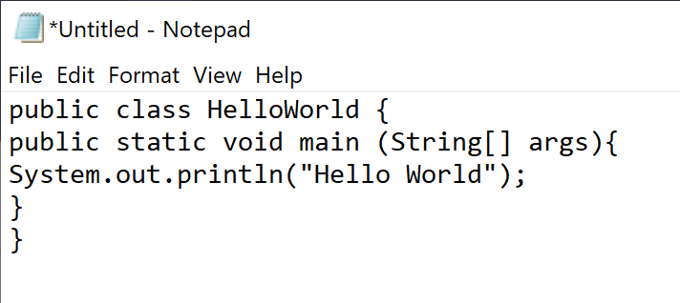
Code in Notepad
You could use a simple text editor to write Java code.
COMPLETE JAVA MASTERCLASS
Confirming installation and intro to JShell

Slide 11
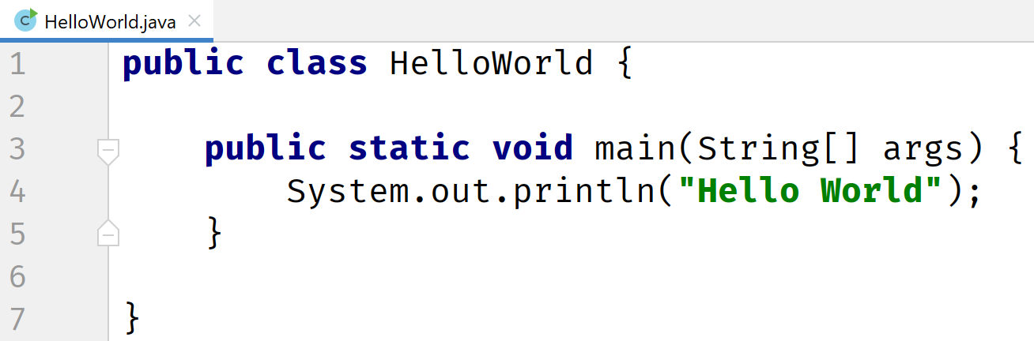
IntelliJ IDE
Most likely, you'll be using an integrated development environment, or IDE, to develop your Java code.
COMPLETE JAVA MASTERCLASS
Confirming installation and intro to JShell

Slide 12
JShell
JShell became a standard component of the Java Developers Kit in Java 9.
It is what is known as a Read-Eval-Print-Loop interactive program (or REPL for short) which means it does pretty much just that:
it reads the command or code segment we type in.
it evaluates and executes the code, and often allows short cuts to be used.
it prints out the results of the evaluation or execution, without making the developer write code to output the results.
Lastly, it loops right back for more input (more code segments or commands).
JShell runs in a terminal (or on the command line for Windows) and is useful for quickly trying out new ideas.
COMPLETE JAVA MASTERCLASS
Confirming installation and intro to JShell

Slide 13
JShell
JShell does not replace the need for an IDE.
It's just a handy tool to quickly get started with Java. We will be transitioning to an IDE later in the course.
COMPLETE JAVA MASTERCLASS
Confirming installation and intro to JShell

Slide 14
Where's the Java code?
Why did we introduce you to JShell, and not write any Java code? I had a good reason for doing this.
Our first Java code is going to be the very traditional program for a beginner, and we'll do that in the next video.
I wanted to get all the JShell commands and usage out of the way, so in the next video, we can concentrate on just Java code. Remember later in the course we will swing over to an IDE instead of JShell.
COMPLETE JAVA MASTERCLASS
Confirming installation and intro to JShell

